Slide 1
SAIP’s Experience on PPH

Slide 2
Contents
Section 1: Overview of Filed Patent applications with SAIP.
Section 2: What Are the Benefits of PPH?
Section 3: Current PPH programs.
Section 4: PPH Statistics.
Section 5: Statistical Data on Examination.

Slide 3
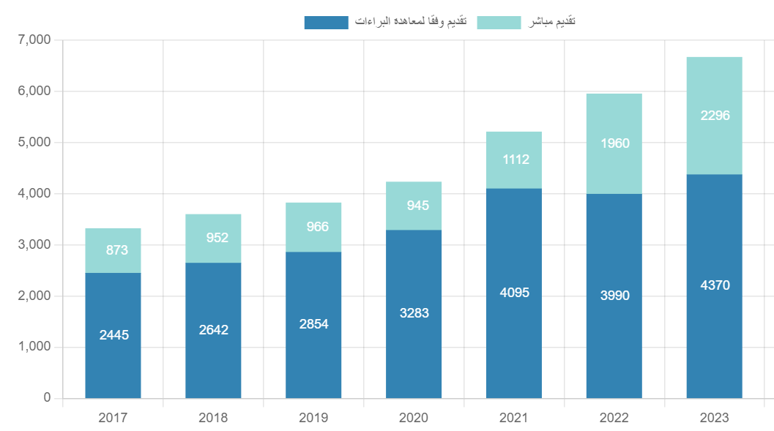
Filed Patent Applications with SAIP (Saudi Arabia)
PCT-Route
Direct-Route

Slide 4
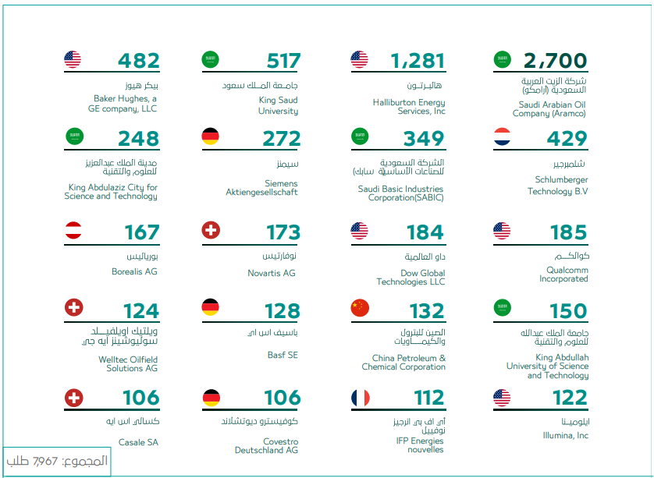
Filed Patent Applications with SAIP by IPC (2012-2022)
Top Patent Applicants
Patent applications of top applicants were focused in :
(1) cracking of hydrocarbon oils and production of liquid hydrocarbon mixtures;
(2) medical and applied medical sciences and therapeutic chemical compounds medical, surgical and diagnostic;
(3) geophysics and digital data processing; and
(4) earth or rock drilling techniques to extract oil or gas.

Slide 5
What Are the Benefits of PPH?
For Applicant
B
Provide quicker patentability determination in multiple jurisdictions
Decreases costs of prosecution.
For Offices
PPH Benefits
A
Avoid redundant work by reuse of OFF work product
Claims reduced in number and narrowed in focus to what was previously allowed
Reduced Pendency

Slide 6
Current PPH programs
 | Pilot |  | Extended |  | Permanent
National Office | Start | End | Start | End | Start
KIPO | July 1, 2019 | July 1, 2022
JPO | Jan 1, 2020 | Jan 1, 2023
USPTO | Jan 1, 2020 | Jan 1, 2023
CNIPA | Nov 1, 2020 | Nov 1, 2023 | Nov 1, 2023 | Indefinite time period
EPO | April 20, 2022 | April 20, 2025
IPOS | Sep 12, 2023 | Sep 11, 2025
INPI | April 30, 2023 | April 30, 2026

Slide 7
PPH Statistics (1/2)
Cumulative number of PPH requests with SAIP (Saudi Arabia) as the Office of Later Examination (OLE)

Slide 8
PPH Statistics (2/2): Number of PPH Requests by IPC
E21B (22% of PPH Requests)
EARTH OR ROCK DRILLING; OBTAINING OIL, GAS, WATER, SOLUBLE OR MELTABLE MATERIALS OR A SLURRY OF MINERALS FROM WELLS.

Slide 9
Statistical Data on Examination
FA Pendency
- PPH cases:
1-1.5 months (from grant of PPH request to FA)
Non- PPH cases:
7.3 Months (from payment date of examination fees to FA)
D Pendency
- PPH cases:
2-3 months (from grant of PPH request to FA)
Non-PPH cases:
18.9 Months (from payment date of examination fees to FA)

Slide 10
Thank you

